Slide 1
CMP203 Graphics Programming
Camera

Slide 2
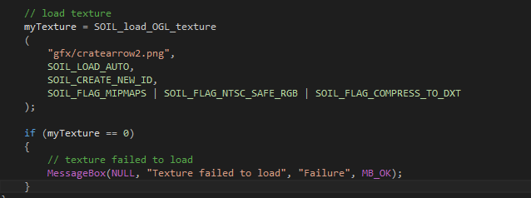
Notes from last week
Load texture in the Scene() constructor, not the render function()
Check if texture loaded

Slide 3
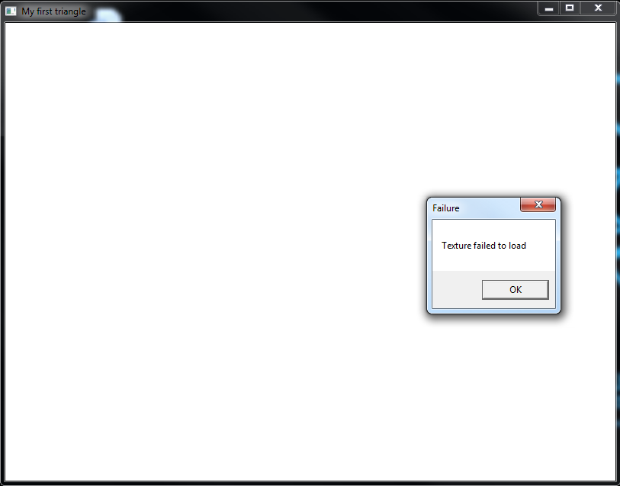

Slide 4
This week
Projection transforms
A simple-ish Camera
Types of camera
Vector 3 class
Implementation
Adding keyboard and mouse control

Slide 5
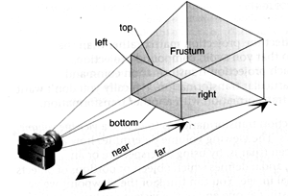
Projection Transform
Frustum – the View Volume
Only objects within the frustum are rendered

Slide 6
Projection Transform
Matrix Modes
In the resize() function are two calls to glMatrixMode()
GL_MODELVIEW tells OpenGL that the next matrices it gets are for model and view manipulation
GL_PROJECTION sets up the projection transform, after it we can specify various parameters that effect the scene rendering
Gets called when the window changes size

Slide 7
Projection Transform
Setting up the Frustum
There is a default set up automatically
glFrustum (left, right, bottom, top, near, far)
Sets up the frustum manually
Can create non symmetric frustums
gluPerspective( fov, aspect ratio, near , far)
Creates the frustum for you, based on the results you want

Slide 8
Projection Transform
With the Projection Transform defined
It is combined with the Viewport Transform
Then applied to the finished scene to produce the rendered output
Note that the Viewport aspect ratio and the frustum aspect ratio should be the same to avoid distortion

Slide 9
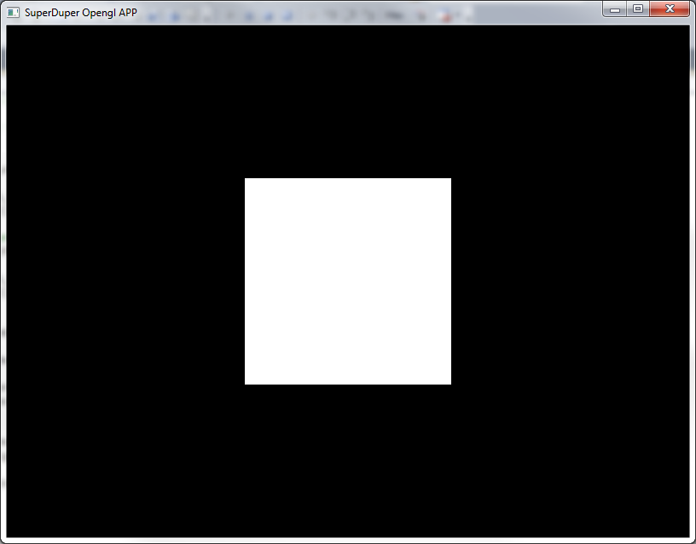
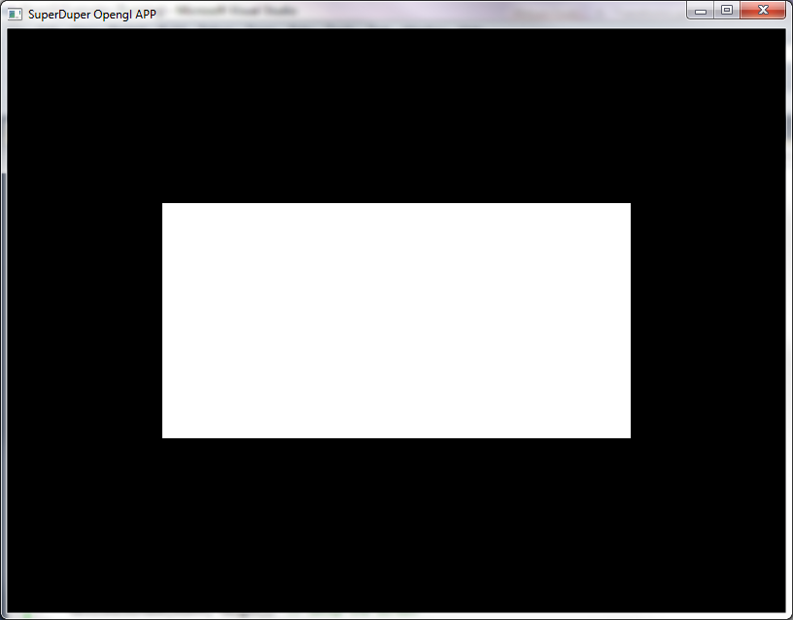
Breaking the perspective
Whoops

Slide 10
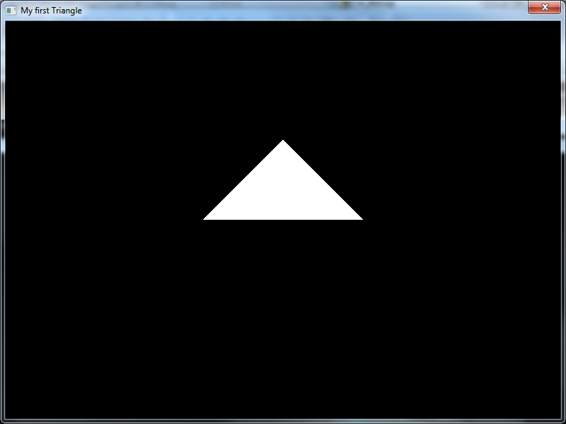
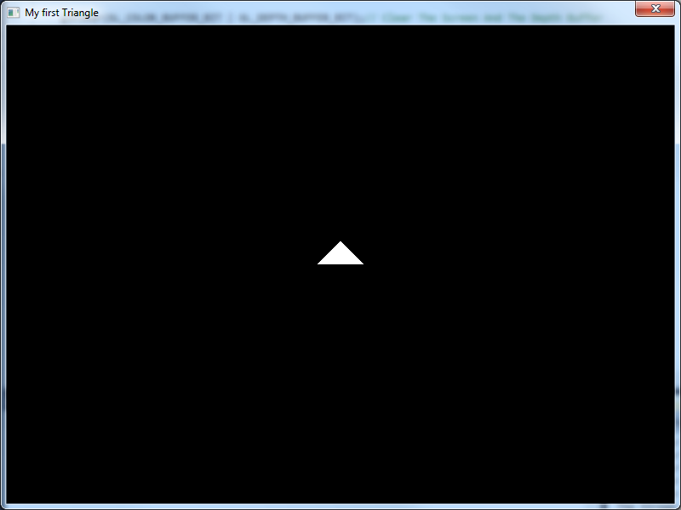
View angle
The first variable is the viewing angle
Normal (45 degrees) vs 120 degrees
gluPerspective(45.0f,(GLfloat)width/(GLfloat)height, 1 ,150.0f);
gluPerspective(120.0f,(GLfloat)width/(GLfloat)height, 1 ,150.0f);

Slide 11
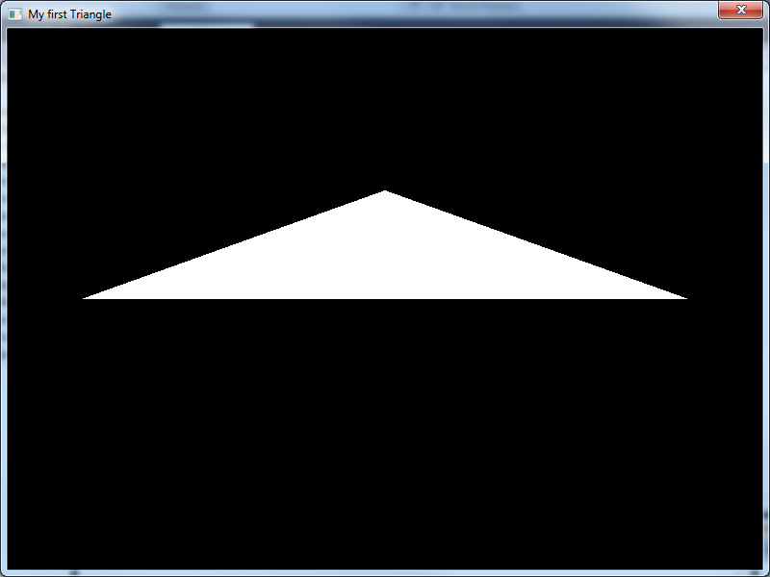
Aspect ratio
This SHOULD match and be based on size of window
If not things go weird
gluPerspective(45.0f, 1/2, 1 ,150.0f);

Slide 12
A Simple Camera
Why do we need a ‘Camera’?
Current we only have a viewpoint
A point in space where our scene is viewed from
It would be nice to look and move around our scene
Best practice is to allow all forms of movement
This is great for debugging
Then limit movement afterwards
Unlikely you will want the user to roll the camera (rotate around the z-axis
Do a barrel roll

Slide 13
Types of camera
Eight basic types
Fixed Point
Doesn’t move, scroll or rotate
What most of you have now
Think Tetris or Bejewelled
Larger games use a collection of Fixed point cameras which change as the player progresses through the level
The challenge is the perspective changes
Rotating
Unable to move but can look around
Used for tracking a character from a fixed point
Or special use cameras (security cameras etc)

Slide 14
Types of camera
Scrolling
Used mainly for 2D games
The camera moves horizontally and vertically
8bit and 16bit platformers and shooters used scrolling cameras
Early Mario games Mega man etc
Moveable
Like scrolling camera, but user controlled
Most common used in RTS, looking down on the scene
Also used in Angry birds or World of Goo, just looking from the side

Slide 15
Types of camera
Floating
Full control
Moves and rotates with no fixed orientation
Total war and Home world
Still usually locks z-axis rotation
Tracking
Tracks an object (usually a character) in 3D space
It may move, rotate, move ahead of the character or fall behind
Player has little or no control over it

Slide 16
Types of camera
Pushable (3rd person)
Have a default position (usually behind the character)
But the player can move the camera around
Camera rotates around the character
First Person
Camera is linked to the character
Movement and rotation is applied to both camera and character
Limited control versions exist
Where player movement or aiming is limited
Bonnet camera in racing games

Slide 17
How?
Two techniques
We could achieve the appearance of camera behaviour by moving and rotating the entire world
But this is bad practice
The cameras angle is dependant on directly manipulating transforms and it can go wrong
It can be complex to try to resolve the aiming / lookat point correctly

Slide 18
How?
OR
We create an object that tracks the variables required for gluLookAt()
Simple to control
Less to go wrong
Some annoying math
Reusable camera object
We can have multiple camera’s in the scene and can switch between them

Slide 19
A Simple Camera
What do we need to calculate?
We are updating gluLookat()
This calculates the camera transform for us
Therefore the information we have to create has to correspond to the information this function requires
Position
Look at
Up
Additionally we may need “Right” will help with movement
These can be simple float variables (representing vectors) or vectors
I will provide a Vector3 class (or use your own)
This is a very common format of information used in multiple API’s
If its not vectors that are required it will be a camera matrix that needs to be calculated

Slide 20
A Simple Camera
What do we want to control?
What do we need to change to have a meaningful camera?
Position
X, y, z coordinates
Orientation via angles.
Pitch (Rotation around x- axis)
Yaw (Rotation around y-axis)
Roll (Rotation around z-axis)
By setting these variables or controlling them via key presses or mouse movement we can begin to have a useable camera

Slide 21
Vector 3 Class
Represents a Vector 3
Store three values
X
Y
Z
Functions for creating and manipulating them
Getters and setters
Operations ( + - )
Scale, normalise etc
I will provide this class I recommend giving it a look over

Slide 22
Using the camera
Required for gluLookAt ()
Position
Look at
Up

Slide 23
Using the camera
Position
gluLookAt ( x , y , z , ….
Location of camera in world space
Camera will store this data
Getters/setters to change/get the data

Slide 24
Using the camera
Look At
gluLookAt (x, y, z, lookat x, lookat y, lookat z , …
A point in world space the camera is looking at
To calculate Look At add the forward vector to the position gives us the Look At point
A point directly in front of the camera (down the forward vector)
Camera has a forward vector (which direction is forward) which is not look at
Camera class should calculate look at and provide functions to return data

Slide 25
Using the camera
Up
gluLookAt(x,y,z,lx,ly,lz, up x, up y, up z)
Up direction relative to the camera
Requires up vector
Calculate an up vector
Camera will store this data
Getters to get the data

Slide 26
Camera Implementation
We are going to create a camera class
Will store position and orientation data
Will calculate camera vectors
Forward
Look at
Up
Right
Provide values required for gluLookAt()
Getters and setters to control the camera
Update the position and rotation

Slide 27
Camera implementation
The core of the camera
A function for calculating the vectors based on current/updated position and rotation
The forward, up (and right) vectors
Given position and rotation these vectors can be calculated using the parametric equation of a sphere
Other camera functions will update position/rotation (then recalculate the vectors)
Return position, look at and up data
For use within gluLookAt()

Slide 28
Camera Implementation
Camera Update function (note this will NOT compile)
void Camera::update()
{
float cosR, cosP, cosY; //temp values for sin/cos from
float sinR, sinP, sinY;
// Roll, Pitch and Yall are variables stored by the camera
// handle rotation
// Only want to calculate these values once, when rotation changes, not every frame.
cosY = cosf(Yaw*3.1415/180);
cosP = cosf(Pitch*3.1415/180);
cosR = cosf(Roll*3.1415/180);
sinY = sinf(Yaw*3.1415/180);
sinP = sinf(Pitch*3.1415/180);
sinR = sinf(Roll*3.1415/180);

Slide 29
Camera Implementation
//This using the parametric equation of a sphere
// Calculate the three vectors to put into glu Lookat
// Look direction, position and the up vector
// This function could also calculate the right vector
forward.x = sinY * cosP;
forward.y = sinP;
forward.z = cosP * -cosY;

Slide 30
Camera Implementation
// Look At Point
// To calculate add Forward Vector to Camera position.
// Up Vector
up.x = -cosY * sinR - sinY * sinP * cosR;
up.y = cosP * cosR;
up.z = -sinY * sinR - sinP * cosR * -cosY;
// Side Vector (right)
// this is a cross product between the forward and up vector.
// If you don’t need to calculate this, don’t do it.
}

Slide 31
Using the Camera
How do we control it
Position
We could easily add/subtract values for the cameras x, y, z
This would move it
But it would move along the axis not the direction the camera is facing
To move the direction the camera is facing
You add the forward vector to the current position
To control speed of movement multiply the forward vector by speed and delta time

Slide 32
Using the Camera
Other movements work similarly
To move up and down
Either move straight up and down the y axis (works for up and down)
Or move along the up vector
To strafe left and right
Move positively and negatively along the right vector (cross product of forward and up vectors)

Slide 33
Using the camera
Rotation
Add/subtract from the three rotation values
X , Y, Z
Pitch, Yaw, Roll
After changing these values make sure to update the camera
Re-calculating the vectors required for gluLookAt
Important to do this one when you change a value and not every frame
And during the scene update() before the render

Slide 34
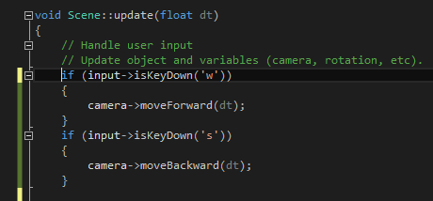
Keyboard controls
Add keyboard controls
We have done plenty of this
Start by focusing on each axis individually
For example get rotating left and right working
Before adding up and down
Same for movement
This will be easier to debug when things go wrong

Slide 35
Debug
For developing and testing your camera build a large room
Here I created a large cube (unit cube scaled up)
With each face a different colour
One object is not enough you will get lost
Have controls to move forward/backward, up/down, left/right and rotate up/down/left/right

Slide 36
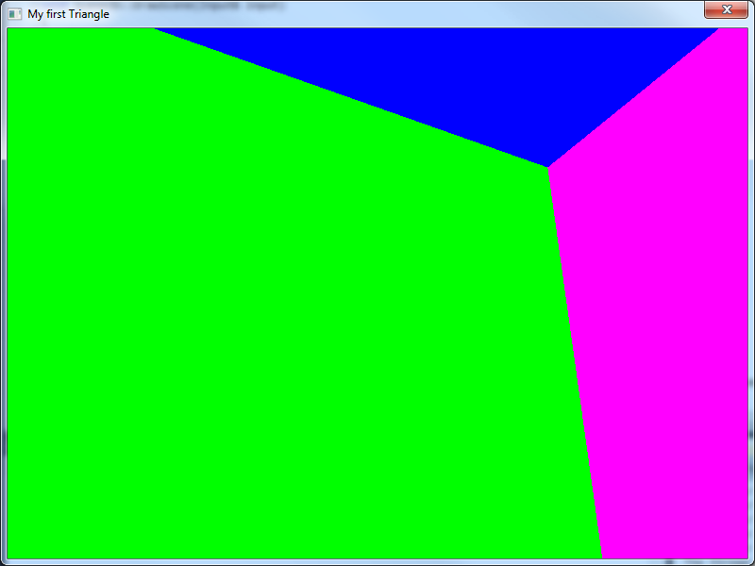

Slide 37
Mouse control
Before we begin I highly recommend you first have it working with keyboard controls
Movement and rotation
Movement
Key presses move along the forward, up, or right vector
Rotation
Key presses update the yaw, pitch and roll of the camera class
Using delta time

Slide 38
Camera control
The overall idea
Using the mouse’s current position calculate how far it is from the centre of the window
Use this distance (in pixels) to update the yaw, pitch and roll of the camera
Force mouse to return to the centre of the window

Slide 39
Camera control
Your input class already stores the mouse’s current position
And updates it whenever the mouse moves
The centre of the window can easily be calculated
Scene class contains width and height of the window
Centre is (width / 2 , height / 2)
Distance moved is current position – centre
Use the distance difference in x and y to update yaw and pitch of camera
May need scaled down to slow movement

Slide 40
Camera control
Forcing the mouse position
glutWarpPointer( int x , int y );
Sends mouse to specified x,y cords
In relation to the window
You will want to set the cursor position to the middle of the screen before rendering
If not the first frame will have mouse movement applied to it
Hide mouse cursor
glutSetCursor(GLUT_CURSOR_NONE);

Slide 41
Debug suggestions
When setting up the camera I highly recommend working with a single axis at a time
Start with rotating left and right
Then just up and down
Then both
This helps isolate bugs
Is easier to put in some magic numbers for testing purposes

Slide 42
Helpful
Maths is fun
If you need some reminding about vectors
http://www.mathsisfun.com/algebra/vectors.html

Slide 43
Information
Labs
Creating your camera
Module Survey
Week 7
Should have received an email
No normal classes
Special group task

